Slide 1
MIS3690 Web Technologies
Babson College
TOIM Division
Fall 2015

Slide 2
Using ID and CLASS for Styles Building tables with HTML Stylizing Tables

Slide 3
Using ID and CLASS
Using CSS with a generic tag (like h1 or p) causes all h1-elements or p-elements to be stylized the same way.
Example: p{color: red;} /*all paragraphs on the page will have a red font.*/
What if you want a specific occurrence of a tag to be stylized differently than other occurrences of the same tag?
What if you want specific occurrences of different tags to be stylized the same way and different from other occurrences of the same tags?

Slide 4
Tag ID
Almost any tag can have an id as one of its attributes
An id should be used only once on a page.
Think of the id as identifying the tag uniquely
Examples:
<p id="bio">
<h1 id="intro">
Notes:
Allows something to apply to only i.d. Overrides existing tag

Slide 5
Applying a Style to an ID
Syntax: tag#id {style}
Examples:
p#bio {color:blue}
The <p> with the id="bio" will have a blue colored font
h1#intro {font-size:24}
The <h1> with the id="intro" will have font-size of 24
The id style adds to and potentially overrules the tag style

Slide 6
ID Example
<style type="text/css">
p#border {border:3px solid red}
</style>
<body>
<p>…</p>
<p>…</p>
<p id="border">…</p> <!--only this paragraph will have a border-->
<p>…</p>
<p>…</p>
</body>

Slide 7
Tag Classes
Almost any tag can have a class as one of its attributes
A class can be used for one or more tags on a page
different from an id – used only once
Think of a class as a group of tags with similar styles
Examples:
<p class="bordered">
<h1 class ="bordered">
Notes:
Classes is if there is more than one

Slide 8
Applying a Style to a Class
Syntax:
tag.class {style}
or .class {style}
Examples:
p.me {color:blue}
Every <p> with class="me" will have a blue colored font
h1.me {font-size:24}
Every <h1> with the class="me" will have font-size of 24
.me {color:blue}
Every tag of any type with class="me" will have a blue colored font
<html>
<head>
<style type="text/css">
</style>
</head>
<body>
<h1 class="me">I am blue </h1>
<h2> I am not </h2>
<p> Neither am I, too bad </p>
<p class="me"> Hey, I am blue </p>
</body>
</html>

Slide 9
Class Example
<style type="text/css">
p.border {border:3px solid red}
</style>
<body>
<p>…</p>
<p class="border">…</p>
<p class="border">…</p>
<p>…</p>
<p class="border">…</p>
</body>
Paragraphs with class = "border" will each have a border

Slide 10
CS05-InClass-1.htm
Please use the file "CS03-InClass.htm", save it as "CS05-InClass-1.htm".
Let us use id and class to format the page further.
Create a red-colored, dotted border, 3px thick, around just the last quote (the one below the line that says "this paragraph will have a border") – leave the quote’s heading out.
Make the color of the heading "Quote 3 from Winston Churchill" green.
The following elements must be in blue font, italicized and underlined.
the first quote (the entire quote),
the title of the second quote "Quote Two from Winston Churchill",
the entire paragraph about the tiger.
Save it and upload to server.

Slide 11
HTML Tables

Slide 12
Why tables?
Allows you to define a structure to display your content.
Makes it easy to "fit" content (especially, images).
Allows you to display more content in a page.

Slide 13
Types of HTML tables
Regular tables
Each row has the same number of cells
Each column has the same number of cells
Standard format – the tabular structure
Irregular tables
Each row need not have the same number of cells
Each column need not have the same number of cells
Gives you more freedom to organize the content of a web page
Must "span" rows and/or columns

Slide 14
Regular Layout Example

Slide 15
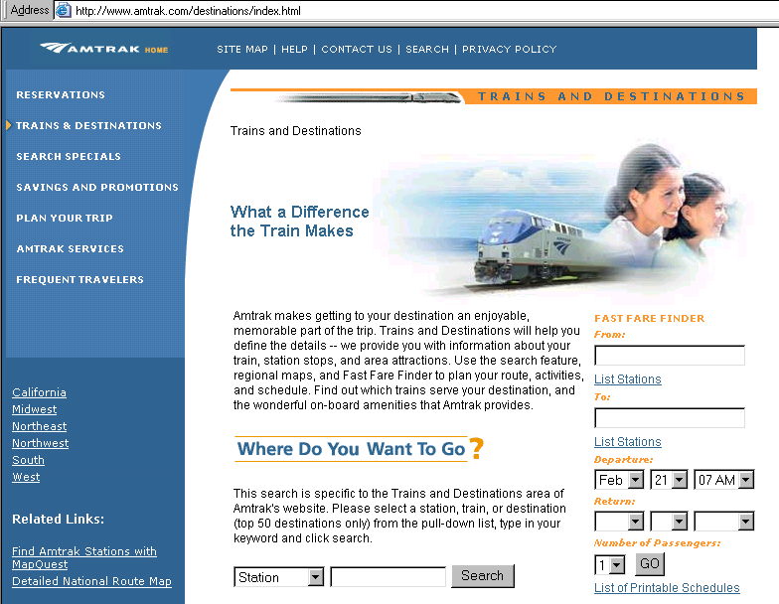
Irregular Layout Example
Irregular tables often blend images and text. Generally they don’t use borders.

Slide 16
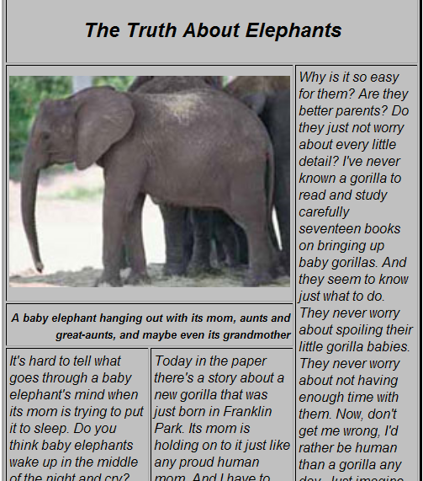
Irregular Layout Example
There is a table that defines the layout of this page – with rows and columns

Slide 17
HTML Table– Mandatory tags
<table>…</table>
Defines table object – should be the outermost
<tr>…</tr>
Defines table row – one set for each row
<td>…</td>
Defines table cell – one set for each cell.
Remember: Table contains rows, rows contain cells with data.
In HTML, table columns are not explicitly defined. You only define table cells – columns are implicit.

Slide 18
How are these tags placed?
Table Row
Table Cell
<table> <tr>
<td>…</td><td>…</td>
</tr> <tr>
<td>…</td><td>…</td>
</tr> </table>
Table
Notes:
Row is horizontal

Slide 19



Regular Tables – more examples
<table>
<tr><td>1</td><td>2</td></tr>
<tr><td>3</td><td>4</td></tr>
</table>
<table>
<tr><td>1</td><td>2</td></tr>
<tr><td>3</td><td>4</td></tr>
<tr><td>5</td><td>6</td></tr>
</table>
<table>
<tr><td>1</td><td>2</td><td>3</td></tr>
<tr><td>4</td><td>5</td><td>6</td></tr>
</table>
All these tables have borders defined using CSS – not shown here

Slide 20
Caption
<caption></caption> can be used to title a table
Must be first item in <table>
Appears only in first page printed or shown

Slide 21
CS05-InClass-2.htm
Suppose you are CEO of a start-up. You want to create a web page for a catalog of your products.
The table should have three columns:
Product Code; Product Description; and Price.
The top row of the table should be a heading saying "Product Code", "Product Description", and "Price".
Each subsequent row should provide the value for one of the catalog items.
Include four catalog items – data can be made up or use what is on the screen.
Add a caption.
Name your file CS05-InClass-2.htm .
We will stylize it next.

Slide 22
CSS-Styles for Tables
<table> tag supports
background,
border,
margin,
padding,
font,
text,
positioning styles
<td> tag support all of above except margin and positioning. You may also use the width style.
<tr> tag seems to support only background, font, and text styles

Slide 23
CSS-Styles for Tables
To center a table on a page
table {margin-right:auto; margin-left:auto}
Width of the table
table {width:600px;} or table {width:70%;}
Width of individual columns
Use CLASS to set width of individual columns

Slide 24
CSS for Tables - example
table {
border:2px solid black; /*defines the outside border*/
font-family: Arial;
color: navy;
width:50%; /* sets the width of table to 50% of width of web-page*/
margin-right:auto; margin-left:auto; /* centers table on page*/
background: url(music.gif); }
td {
border: 2px solid black; /* defines the border for each cell*/
vertical-align:top; /* defines the vertical alignment of text in each cell*/
text-align:center; }
tr#top {background-color:yellow; font-weight:bold;}

Slide 25
CS05-InClass-2.htm (cont.)
Add styles to the catalog table.
Save it and upload it to FTP.

Slide 26
Irregular Tables
Irregular tables have cells that cross over one or more rows or columns
For a cell that covers two or more columns, use <td colspan="x">data</td>, where x is the number of columns spanned
For a cell that covers two or more rows, use <td rowspan="x">data</td>, where x is the number of rows spanned

Slide 27


Irregular Tables Using "colspan"
<table>
<tr><td>1</td><td>2</td></tr>
<tr><td colspan="2">3</td></tr>
</table>
<table>
<tr><td>1</td><td>2</td><td>3</td></tr>
<tr><td>4</td><td colspan="2">5</td></tr>
<tr><td colspan="3">6</td></tr>
</table>
All these tables have borders defined using CSS – not shown here

Slide 28


Irregular Tables Using "rowspan"
<table>
<tr><td>1</td>
<td rowspan="2">2</td></tr>
<tr><td>3</td></tr>
</table>
<table>
<tr><td>1</td><td>2</td>
<td rowspan="3">3</td></tr>
<tr><td>4</td><td rowspan="2">5</td></tr>
<tr><td>6</td></tr>
</table>
All these tables have borders defined using CSS – not shown here

Slide 29

Irregular Table example with rowspan and colspan
<table>
<tr><td>1</td><td colspan="2">2</td></tr>
<tr><td rowspan="2"> 3</td><td>4</td><td>5</td></tr>
<tr><td>6</td><td>7</td></tr>
</table>
All these tables have borders defined using CSS – not shown here

Slide 30
Cell (<td>) Alignment Attributes
Vertical-align: (Vertical Alignment)
top, center, bottom

Slide 31
Nesting Tables
Outer Table
2 rows, 1 column
Inner Table
2 rows, 2 columns

Slide 32
Nesting Tables
<table>
<tr><td>…</td></tr>
<tr><td>
<table> <tr><td>…</td><td>…</td></tr> <tr><td>…</td><td>…</td></tr>
</table>
</td></tr>
</table>
Outer Table
Inner
Table
32

Slide 33
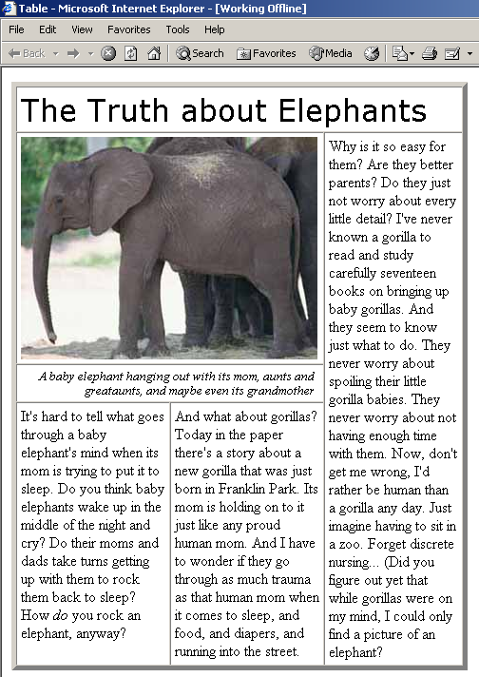
Next ..
We will walk through the design of this page.
We can then review the different types of Lists (that may have been covered earlier). Come prepared to ask questions.

